Slide 1
MIS 584 Project Final NYC Taxi Fare Prediction
Team 12
Yash Jethmalani​ Abhimanyu Paldiwal​ Zhuo Huang

Slide 2
Agenda
01
02
03
04
Problem Statement
Mid-term Recap
Baseline
Algorithms
Performance
Conclusion
05
06

Slide 3
Problem Statement
Traditional taxi services are unable to provide estimated fares for users.
Our goal is to figure out the uncertainty of traditional taxi service and provide users their estimated taxi fare to compare with other riding services, like Uber and Lyft

Slide 4
Mid-term Recap
Data Description
Collected from Kaggle’s New York City Taxi Fare Prediction
Status: Size – 5.31 GB Rows – 55.4 million rows
Column​ | Data Type​
Order date (key)​ | datetime​
Fare amount (predicted)​ | float​
Pickup datetime​ | datetime​
Pickup longitude​ | float​
Pickup latitude​ | float​
Dropoff longitude​ | float​
Dropoff latitude​ | float​
Passenger count​ | integer​
Dataset Source: https://www.kaggle.com/c/new-york-city-taxi-fare-prediction/data​

Slide 5

Mid-term Recap
Data Preprocessing
Subset the data frame with fare amount values > = $2.5
Fare amount
Remove the passenger counts values < 0 and > 6
Passenger count
Remove null values in dataset by using pandas drop function
Null values

Slide 6


Mid-term Recap
Feature Engineering
Absolute Latitude Difference
Absolute Longitude Difference
Manhattan
Euclidean
Haversine

Slide 7
Mid-term Recap
Dataset Description: After Transformations
This is our final dataset use to implement our algorithms
Column​ | Data Type​
Fare amount (predicted)​ | float​
Passenger count​ | integer​
Abs. Latitude difference | float
Abs. Longitude difference | float
Manhattan Distance | float
Euclidean Distance | float
Haversine Distance | float
Dataset Source: https://www.kaggle.com/c/new-york-city-taxi-fare-prediction/data​

Slide 8
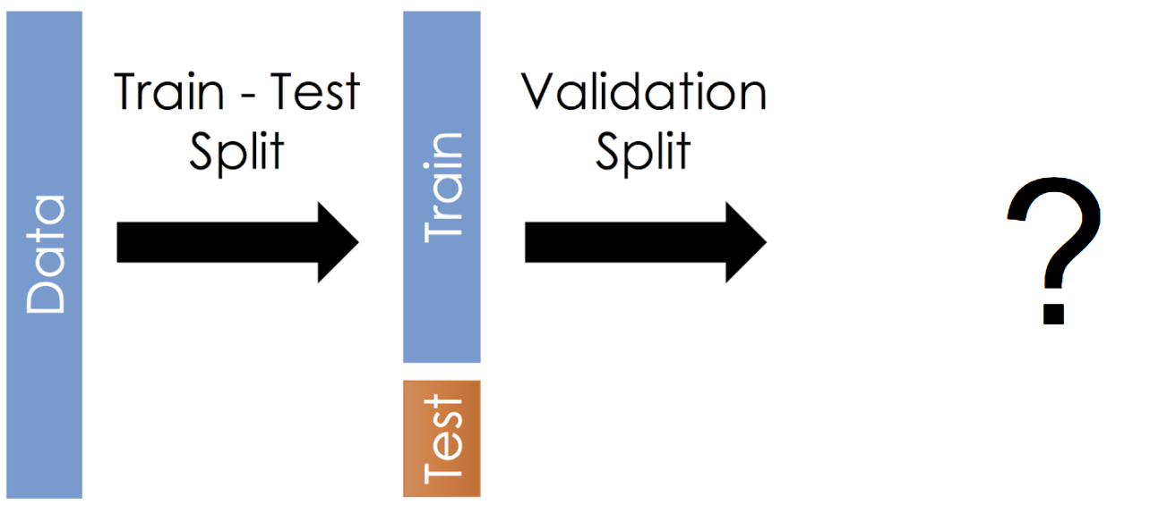


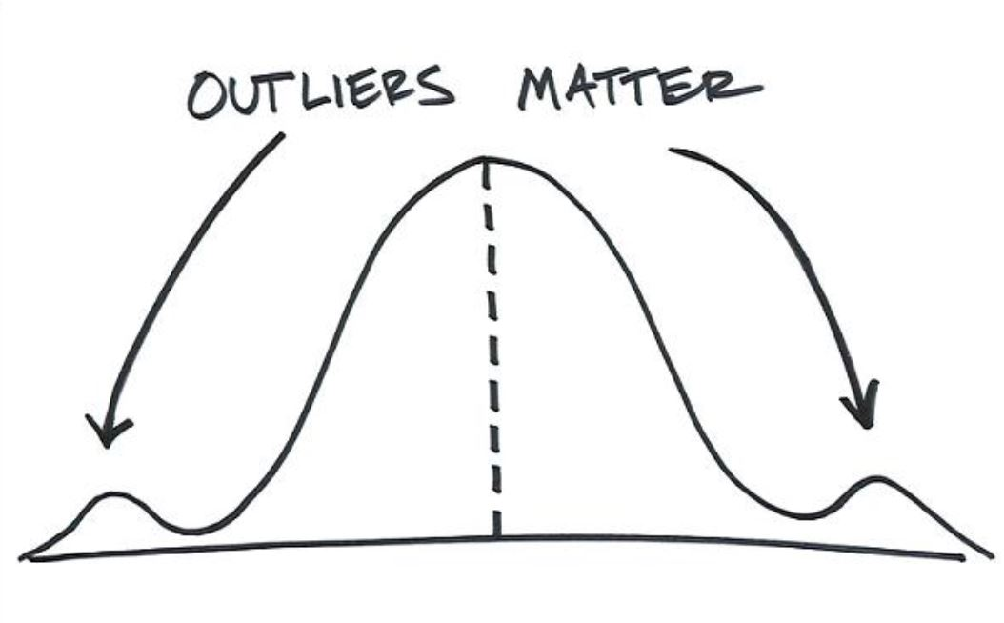


Stratification
Fare Amount
Less Outliers
55 Million
Train - Test Split
Stratification

Slide 9
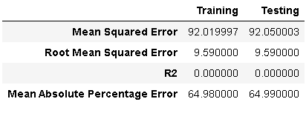
Old Baseline
Features (abs_lat_diff, abs_lon_diff, passenger_count)
Linear Regression

Slide 10
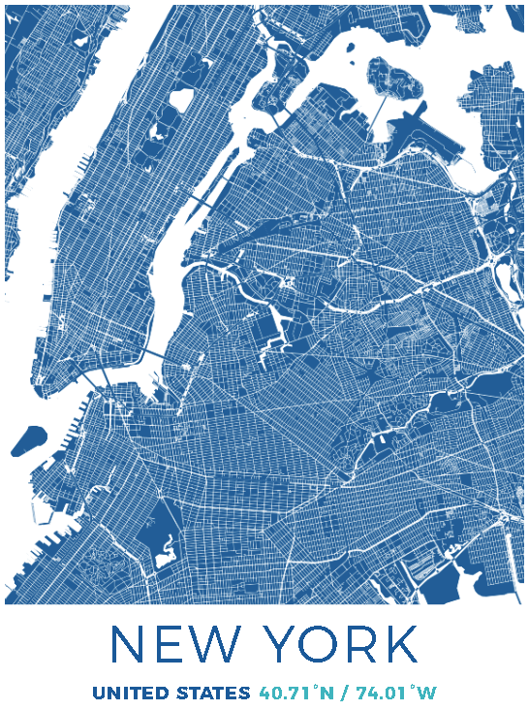

Location
Latitudes and Longitudes that have values near 0 cannot be correct since NYC is at (40,-74) approximately.
All observations that lie outside the interval formed by the 2.5 and 97.5 percentiles will be considered as potential outliers.
40 <= Latitude <= 42
-75 <= Longitude <= -72

Slide 11
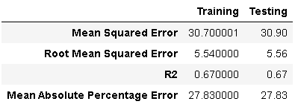
New Baseline
Features (abs_lat_diff, abs_lon_diff, passenger_count)
Linear Regression

Slide 12
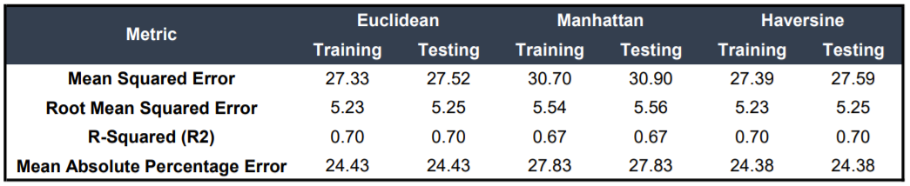
Feature Selection
Linear Regression – Relative Distance Comparison

Slide 13
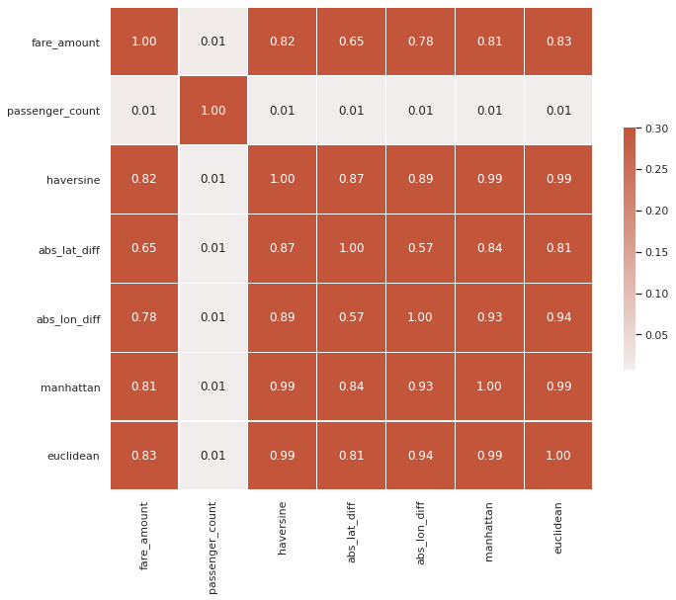
Algorithms: Correlation Matrix

Slide 14
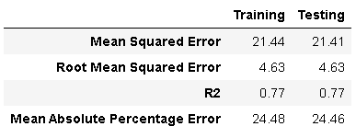
Algorithms: XGBoost Regression

Slide 15
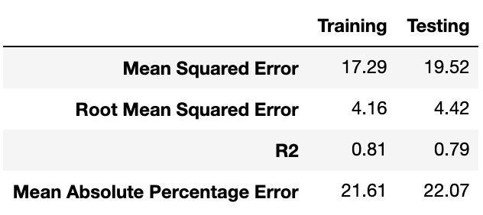
Algorithms: Random Forest Regression
N-estimators: 20 Max depth: 20

Slide 16
Performance
Metrics | Baseline | Linear Regression (Haversine) | XGBoost Regression | Random Forest Regression
MSE | 3.90 | 27.59 | 21.41 | 19.52
RMSE | 5.56 | 5.25 | 4.63 | 4.42
R2 | 0.67 | 0.70 | 0.77 | 0.79
MAPE | 27.83 | 24.38 | 24.46 | 22.07
Training Time | ~3s | ~ 4s | ~ 17min | ~ 22min
Prediction Time | ~2s | ~ 3s | ~ 14s | ~ 1min 30s

Slide 17
Conclusion
Memory Optimization
Feature Engineering
Ensemble Based Models
Crucial for running 55+ million rows
Choosing the right distance measure improved our predictions
Random Forest Regression provides more accurate results

Slide 18
THANK YOU!

Slide 19
Q & A

